Slide 1
Chapter 16: Classes and Data Abstraction
Outline
16.1 Introduction
16.2 Implementing a Time Abstract Data Type with a Class
16.3 Class Scope and Accessing Class Members
16.4 Separating Interface from Implementation
16.5 Controlling Access to Members

Slide 2
Objectives
In this chapter, you will learn:
  To understand the software engineering concepts of en­capsulation and data hiding.
  To understand the notions of data abstraction and ab­stract data types (ADTs).
  To be able to create C++ ADTs, namely classes.
  To understand how to create, use, and destroy class objects.
  To be able to control access to object data members and member functions.

Slide 3
16.1 Introduction
Object-oriented programming (OOP)
  Encapsulates data (attributes) and functions (behavior) into packages called classes
  Data and functions closely related
Information hiding
  Implementation details are hidden within the classes themselves
Unit of C++ programming: the class
  A class is like a blueprint – reusable
  Objects are instantiated (created) from the class
  For example, a house is an instance of a “blueprint class”
  C programmers concentrate on functions

Slide 4
16.2 Implementing a Time Abstract Data Type with a Class
Classes
  Model objects that have attributes (data members) and behaviors (member functions)
  Defined using keyword class
1 class Time {
Public: and Private: are member-access specifiers.
2 public:
3 Time();
4 void setTime( int, int, int );
setTime, printMilitary, and printStandard are member functions.
Time is the constructor.
5 void printMilitary();
6 void printStandard();
7 private:
8 int hour; // 0 - 23
9 int minute; // 0 - 59
10 int second; // 0 - 59
hour, minute, and second are data members.
11 }; // end class Time

Slide 5
16.2 Implementing a Time Abstract Data Type with a Class (II)
Format
  Body delineated with braces ({ and })
  Class definition terminates with a semicolon
Member functions and data
Public - accessible wherever the program has access to an object of class Time
Private - accessible only to member functions of the class
Protected - discussed later in the course

Slide 6
16.2 Implementing a Time Abstract Data Type with a Class (III)
Constructor
  Special member function that initializes data members of a class object
  Constructors cannot return values
  Same name as the class
Definitions
  Once class defined, can be used as a data type
Time sunset, // object of type Time
arrayOfTimes[ 5 ], // array of Time objects
*pointerToTime, // pointer to a Time object
&dinnerTime = sunset; // reference to a Time object
Note: The class name becomes the new type specifier.

Slide 7
16.2 Implementing a Time Abstract Data Type with a Class (IV)
Binary scope resolution operator (::)
  Specifies which class owns the member function
  Different classes can have the same name for member functions
Format for definition class member functions
ReturnType ClassName::MemberFunctionName( ){
…
}

Slide 8
16.2 Implementing a Time Abstract Data Type with a Class (V)
If member function is defined inside the class
  Scope resolution operator and class name are not needed
  Defining a function outside a class does not change it being public or private
Classes encourage software reuse
  Inheritance allows new classes to be derived from old ones
In following program
  Time constructor initializes the data members to 0
    Ensures that the object is in a consistent state when it is created

Slide 9
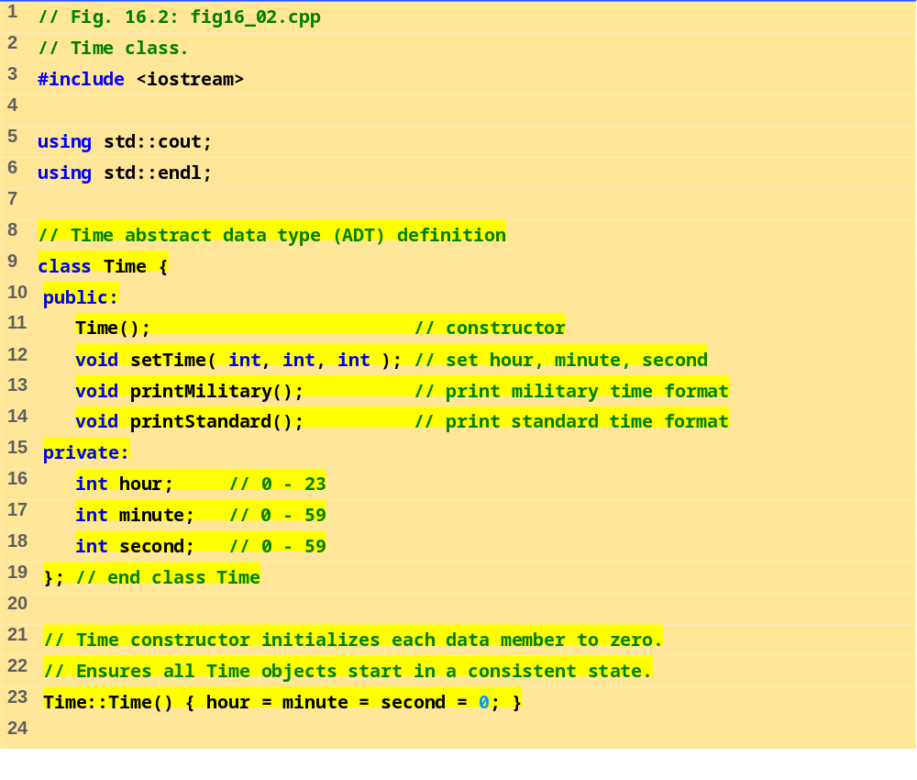
fig16_02.cpp (Part 1 of 3)

Slide 10
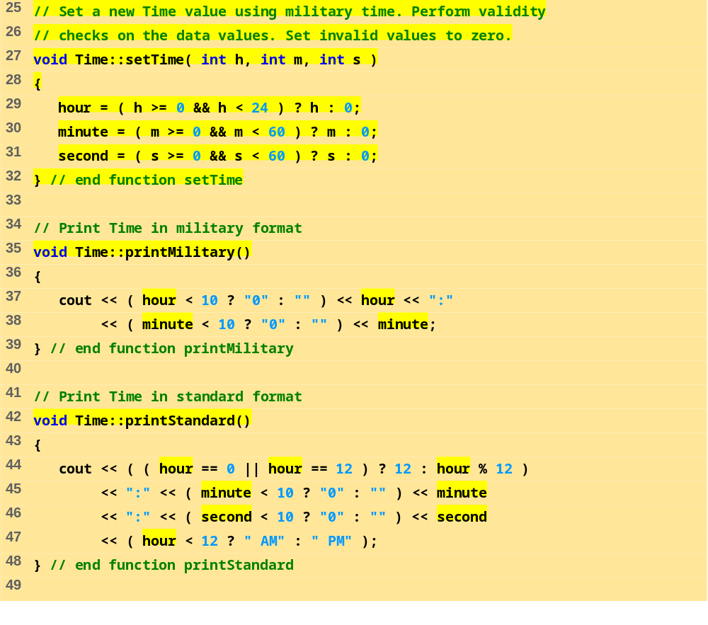
fig16_02.cpp (Part 2 of 3)

Slide 11
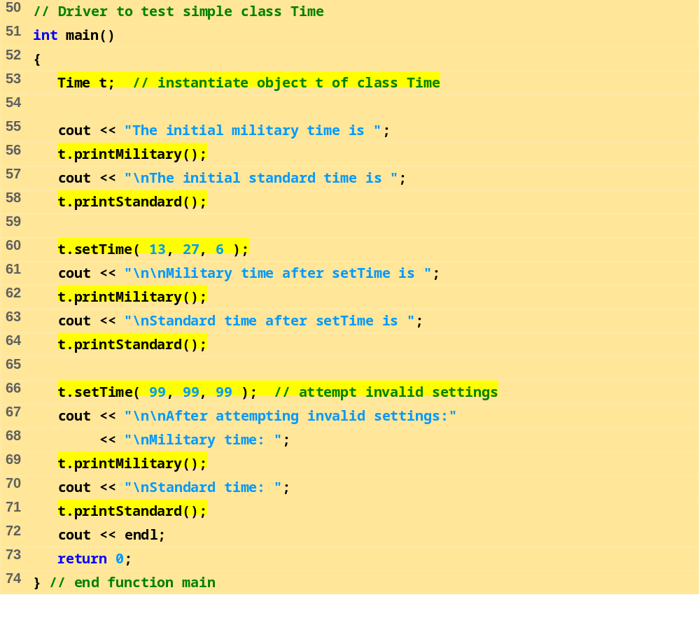
fig16_02.cpp (Part 3 of 3)

Slide 12
Program Output
The initial military time is 00:00
The initial standard time is 12:00:00 AM
Military time after setTime is 13:27
Standard time after setTime is 1:27:06 PM
After attempting invalid settings:
Military time: 00:00
Standard time: 12:00:00 AM

Slide 13
16.3 Class Scope and Accessing Class Members
Class scope
  Data members and member functions
File scope
  Nonmember functions
Function scope
  Variables defined in member functions, destroyed after function completes
Inside a scope
  Members accessible by all member functions
  Referenced by name

Slide 14
16.3 Class Scope and Accessing Class Members (II)
Outside a scope
  Use handles
    An object name, a reference to an object or a pointer to an object
Accessing class members
  Same as structs
  Dot (.) for objects and arrow (->) for pointers
  Example: t.hour is the hour element of t
  TimePtr->hour is the hour element

Slide 15
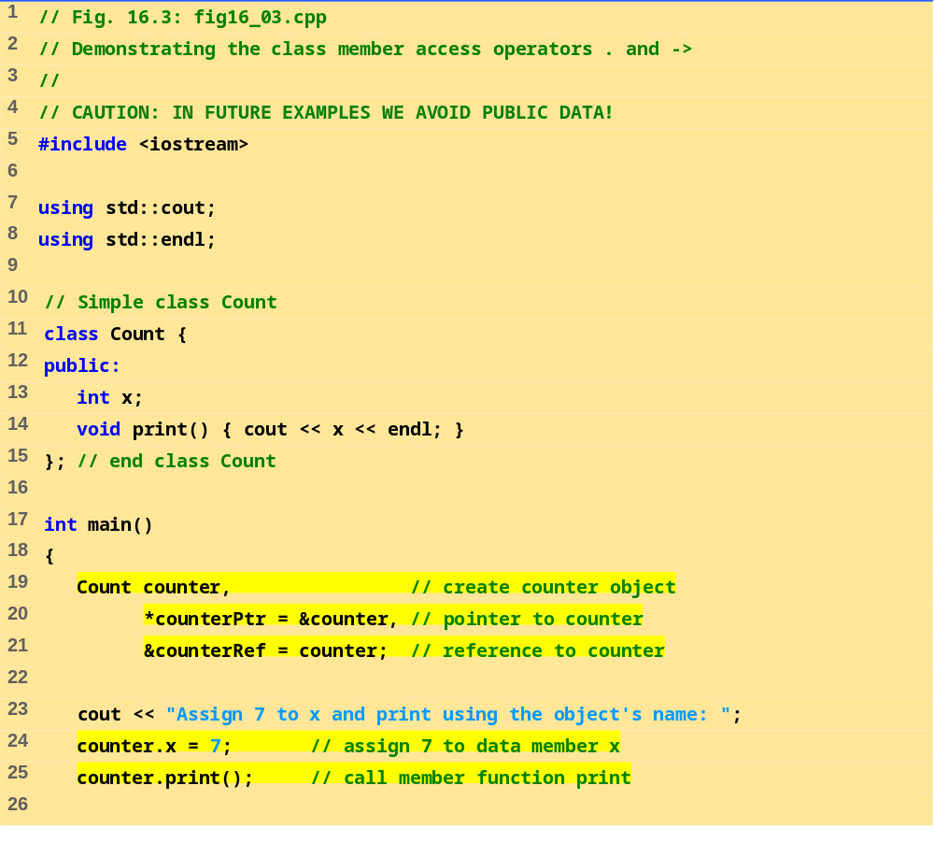
fig16_03.cpp (Part 1 of 2)

Slide 16
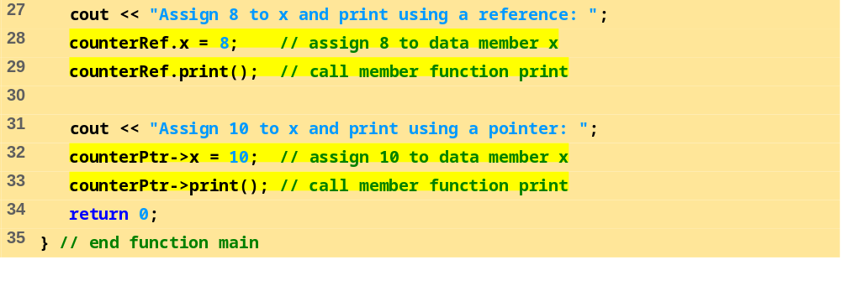
fig16_03.cpp (Part 2 of 2)
Program Output
Assign 7 to x and print using the object's name: 7
Assign 8 to x and print using a reference: 8
Assign 10 to x and print using a pointer: 10

Slide 17
16.4 Separating Interface from Implementation
Separating interface from implementation
  Easier to modify programs
  C++ programs can be split into
Header files – contains class definitions and function prototypes
Source-code files – contains member function definitions
Program Outline:
  Using the same Time class as before, create a header file
  Create a source code file
    Load the header file to get the class definitions
    Define the member functions of the class

Slide 18
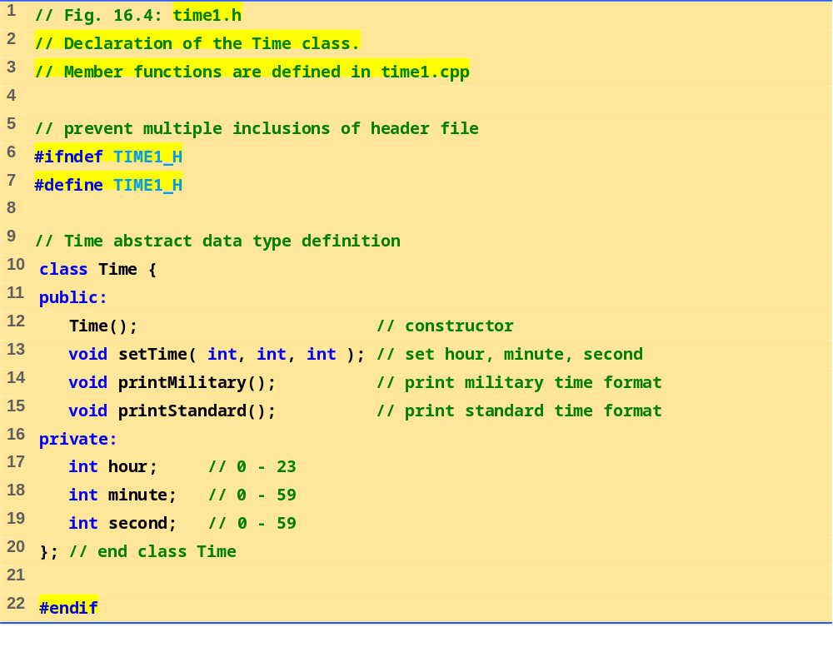
time1.h

Slide 19
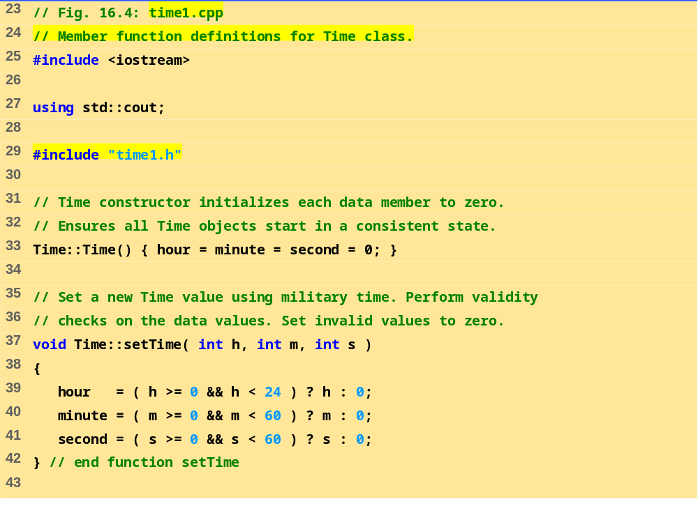
time1.cpp (Part 1 of 2)

Slide 20
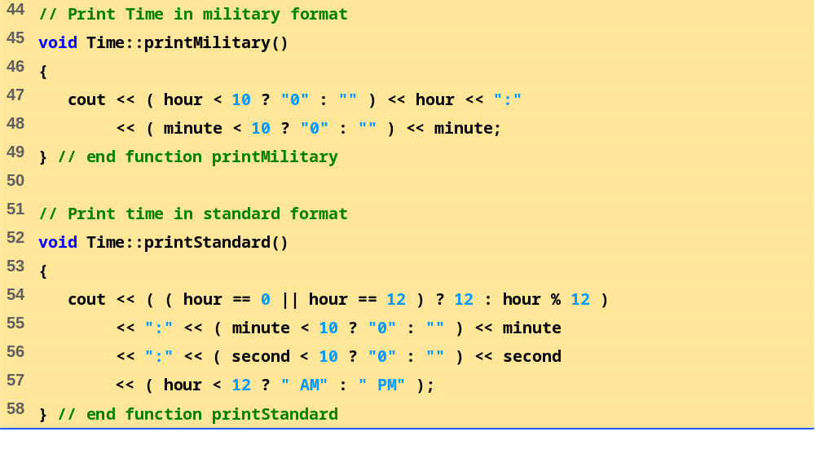
time1.cpp (Part 2 of 2)

Slide 21
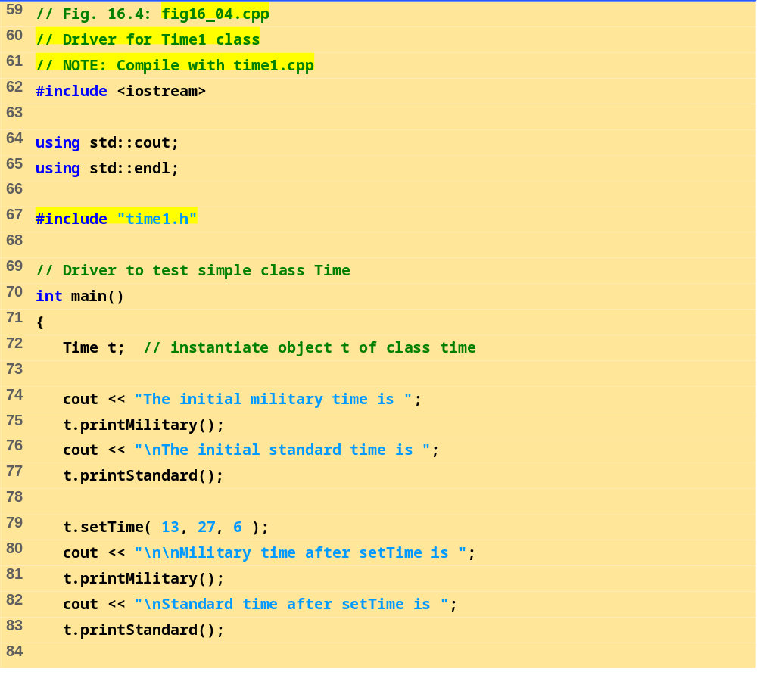
fig16_04.cpp (Part 1 of 2)

Slide 22
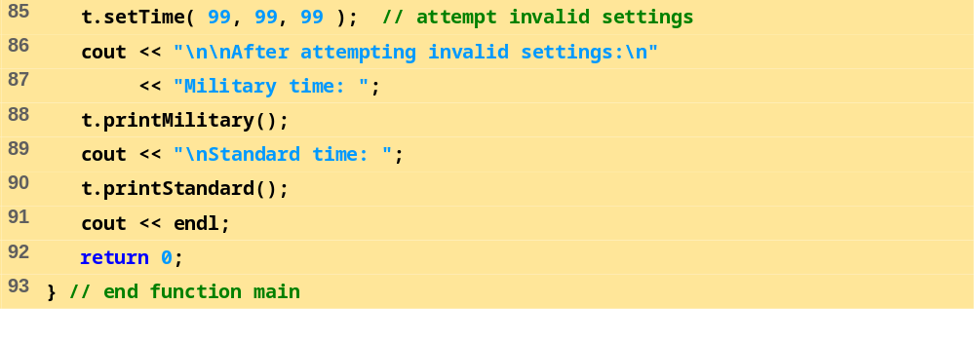
fig16_04.cpp (Part 2 of 2)
Program Output
The initial military time is 00:00
The initial standard time is 12:00:00 AM
Military time after setTime is 13:27
Standard time after setTime is 1:27:06 PM
After attempting invalid settings:
Military time: 00:00
Standard time: 12:00:00 AM

Slide 23
16.5 Controlling Access to Members
Purpose of public
  Give clients a view of the services the class provides (interface)
Purpose of private
  Default setting
  Hide details of how the class accomplishes its tasks (implementation)
  Private members only accessible through the public interface using public member functions

Slide 24
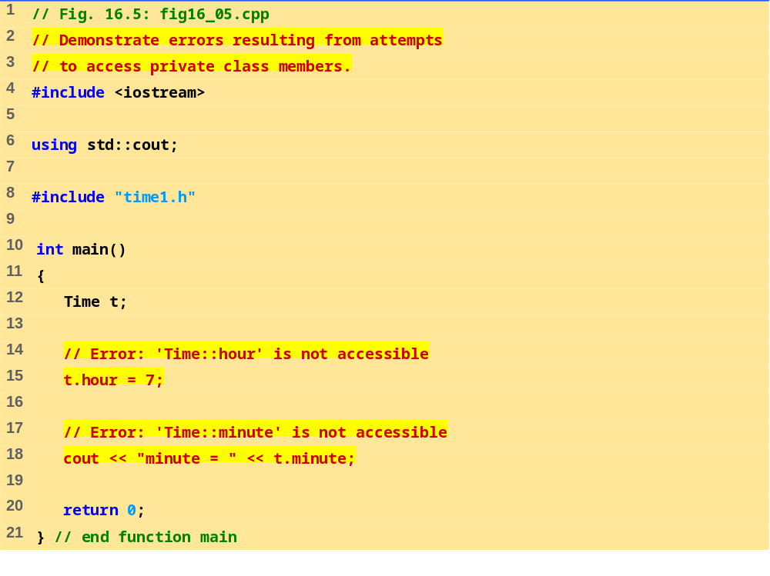
fig16_05.cpp

Slide 25
Program Output
Borland C++ command-line compiler error messages
Time1.cpp:
Fig16_05.cpp:
Error E2247 Fig16_05.cpp 15:
'Time::hour' is not accessible in function main()
Error E2247 Fig16_05.cpp 18:
'Time::minute' is not accessible in function main()
*** 2 errors in Compile ***
Microsoft Visual C++ compiler error messages
Compiling...
Fig16_05.cpp
D:\Fig16_05.cpp(15) : error C2248: 'hour' : cannot access private
member declared in class 'Time'
D:\Fig16_05\time1.h(18) : see declaration of 'hour'
D:\Fig16_05.cpp(18) : error C2248: 'minute' : cannot access private
member declared in class 'Time'
D:\time1.h(19) : see declaration of 'minute'
Error executing cl.exe.
test.exe - 2 error(s), 0 warning(s)

